Slide 1
Results Oriented Website Quickstart
[MM.DD..YY]
[PRESENTER]
Get ready:
Sign in up front
Pickup Student Manual handout
Sign into WiFi: levelten-guest
pw:levelten
Install Dev Desktop
Exercise 1.1
Import Open Enterprise
Exercise 1.2
Notes:
Welcome the Results Oriented Website Quickstart. The goal of this course is to help you build better websites. But not just better in any way, websites that get better results.
But what is a results oriented website. Before we get into that, lets talk about typically websites.

Slide 2
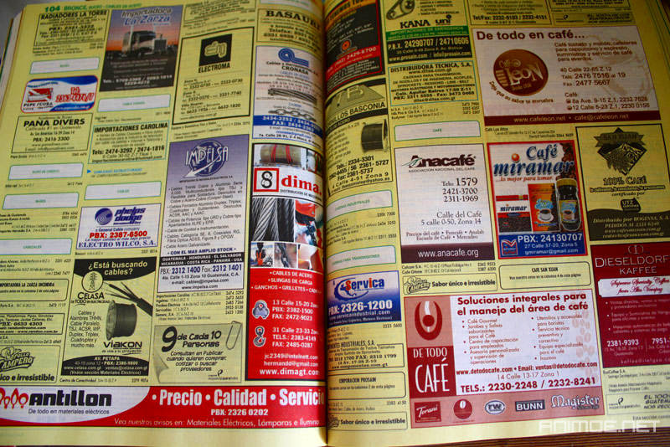
flickr.com/photos/phossil/5117978738
Notes:
Who knows what this?
Has anyone ever advertised in the Yellow pages?
Has anyone here not ever used a Yellow pages

Slide 3
Pop Quiz - Story Problem
In 2001, the Yellow Pages generates 100,000 bike sales in a year. There are 100 bike stores listed.
What is the average number of bikes a typical store should sell in a year from the yellow pages?
flickr.com/photos/silvery/4461519535
Notes:
Who knows what this?
Has anyone ever advertised in the Yellow pages?
Has anyone here not ever used a Yellow pages

Slide 4
distribution of success?
average
Notes:
He is what we would expect

Slide 5
Pop Quiz - Story Problem
In 2001, each of the 100 bikes stores started a website. In 2011, the web generates 100,000 bikes sales in a year.
What is the average number of bikes a typical store should sell in a year from the internet?
Notes:
Who knows what this?
Has anyone ever advertised in the Yellow pages?
Has anyone here not ever used a Yellow pages

Slide 6
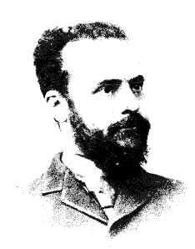
Vilfredo Pareto
Notes:
Who knows what Vifredo Pareto is famous for?
He is most famous for the Pareto Principal, also called the 80/20 rule. Interestingly enough, Pareto did not create this rule. An economist name Joseph Juran created it in the 1930’s and named it after Pareto to honor his work in quantitative economics.
Parteo was actually concerned about a different problem. The distribution of wealth in free markets. He studied the wealth, in particular the land ownership, of families in Italy. Any idea what he found?
20% of the people owned 80% of the wealth.

Slide 7
distribution of success?
typical
leaders
Notes:
What he found is that in free markets, wealth distributions follow a power law. The rich get richer. The few at the top capture the majority of the wealth. The norm receive very modest returns.
The internet is about a free a market as there is. So how to you think the typical site fairs.

Slide 8
cornerstones of highly successful web presences
business process improvement
retention
conversion
brand
engagement
audience
continual innovation
Notes:
So the question is how to you get to the top of the food chain?
[do the speel]

Slide 9
What is this course?
Session 1 – Content management
Session 2 – Theming and extending
Session 3 – Online marketing
Intro to ROW
Installation
Adding & editing content
Page layouts
Themes
Extending your site
Search Engine Optimization
Social Media
Session 4 – Product management
Agile project management
What’s next
Navigation
User & usage centric design
Results
strategy
tools
skills
process
Notes:
This course is designed to give you a foundation for building results oriented websites. We are going to take a hands on approach. We will be actually building a website, doing search engine optimization and social media. As we build our skills with the tools, we will be interspersing strategy and tips. The last section of the course we will be looking at a process to manage it all.

Slide 10
Who is it for?
DIY
Small business owners
Non-profits
Managers & Stakeholders
Marketing & communications
Web professionals
Technology directors
Developers
Online Marketers
Graphic designers
Copywriters
Startups
Web team managers
Notes:
Who is the class for? It is designed to help a few different groups of people.
This is a great workshop for Do It Yourselfers. In fact one of the inspirations for this course was to help small businesses and non-profits climb out of the wasteland of budget level websites. Most budget level website, those that cost less than $10,000 dollars, are not particularly good looking, not managable, have no traffic and produce no results. This course was designed to teach you how to build a solid website that actually gets results on your own.
Maybe you do have a bigger budget and need to manage a team, either internally or outsourced – but you want to know what is possible. What are the latest tools and strategies? This course will teach you the state-of-the-art and will help you work better and more efficiently with your team.

Slide 11
Get some results
typical
jumpstart goal
leaders
Notes:
Of course, the real challenge is how do we get to be the best. Particularly given that there are likely a dozen or so organizations in your niche that have spent years building a competitive web presence. The have likely invested significant amounts of money and effort over several years building their presence. How are we going to out perform them.
The reality is that if you are up against sites that have been effectively building a leading presence for years, you won’t beat them. At least not all the time. It does take significant amounts of time, effort to get to the top. This is actually a good thing. If you invest in build a great presence, you have a significant competitive advantage that is very difficult for others to over come.
The goal of this course is 3 fold.
To help you beat out the 90% plus of websites that are not focused on being results oriented.
To give you a solid foundation, fast tracking your path to being a industry leading website if you choose to take things to the next level.
To do this in a highly cost effective way.

Slide 12
online corporate communications
word of mouse
online advertising & PR
performance based ads
(paid search)
content networking
user centered listings
(organic search)
Awareness referrals
offline
communications
traditional advertising & PR
website
social media
landing pages
engagement content
social content
brochureware
Peer recommendations
user engagement
traditional sales
conversion mechanisms
Authority recommendations
customer relationship management
touch pieces
retention programs
user
requests
trusted advisor
requests
Reputation
Management
custom service

Slide 13
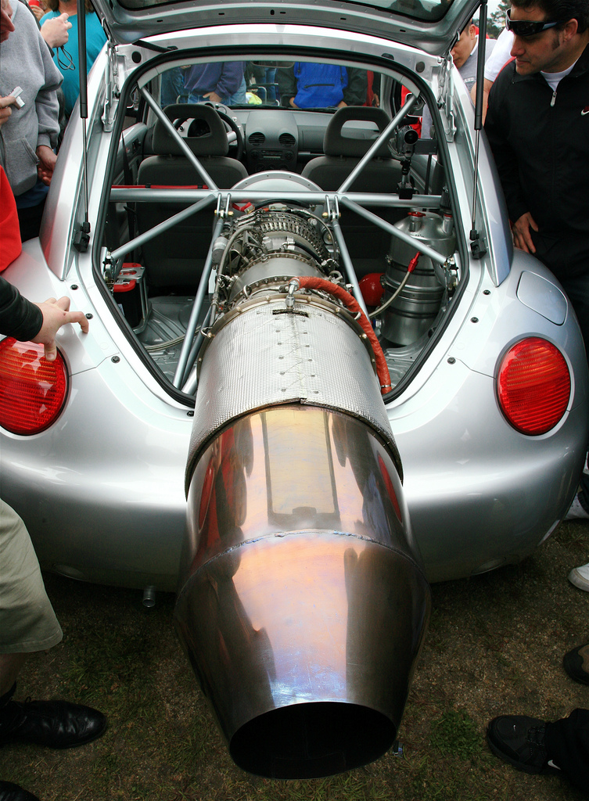
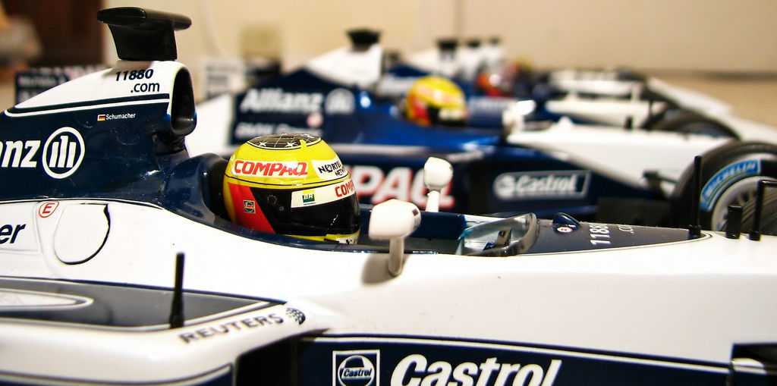
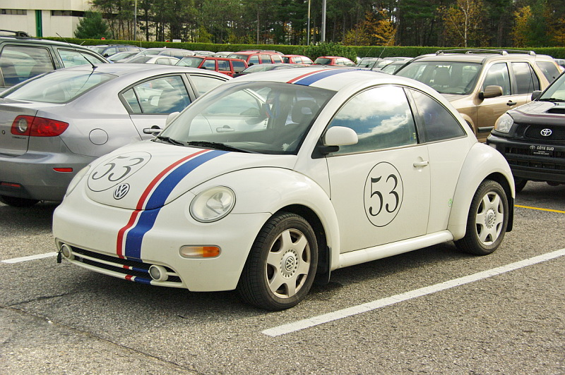
flickr.com/photos/jurvetson
flickr.com/photos/pochacco20
flickr.com/photos/mario_groleau
Notes:
I didn’t have an immediate answer. To build a top website is like building a high performance racecar. It takes do it right took a lot of expertise. You needed solid creative designer, a front end themer, a programmer for the server side work, a marketing expert, usability analyst, project management. It really takes a village to make a great site, and those teams don’t come cheap.
It is highly unlikely that on a tight budget you can find any one or group of people to do it write.
So, then I thought about another option, DIY, do it yourself. A few years earlier this was not particularly feasible, it required a significant mount of technical expertise to code a site. But there were these web applications called content management systems that had come a long ways in a few short years. They do allow non-programmers to build websites. OK so now we could get a solid vehicle for free.
If we could teach people how to trick their vehicle out, now we could be competitive. We could go out and actually win a few.

Slide 14
The platform
Notes:
Talk about CMSs

Slide 15
The big three CMSs
WordPress
Joomla
Drupal
Simple
Advanced
Notes:
It powers some of the world’s top websites such as whitehouse.gov, The Economist and Examiner, all of Sony / BMG’s mission websites.

Slide 16
The Drupal phenomenon
Notes:
It powers some of the world’s top websites such as whitehouse.gov, The Economist and Examiner, all of Sony / BMG’s mission websites.

Slide 17
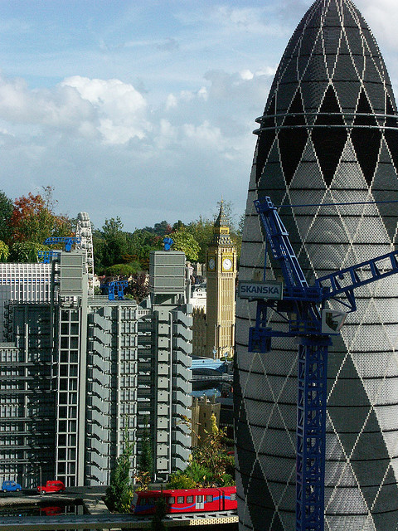
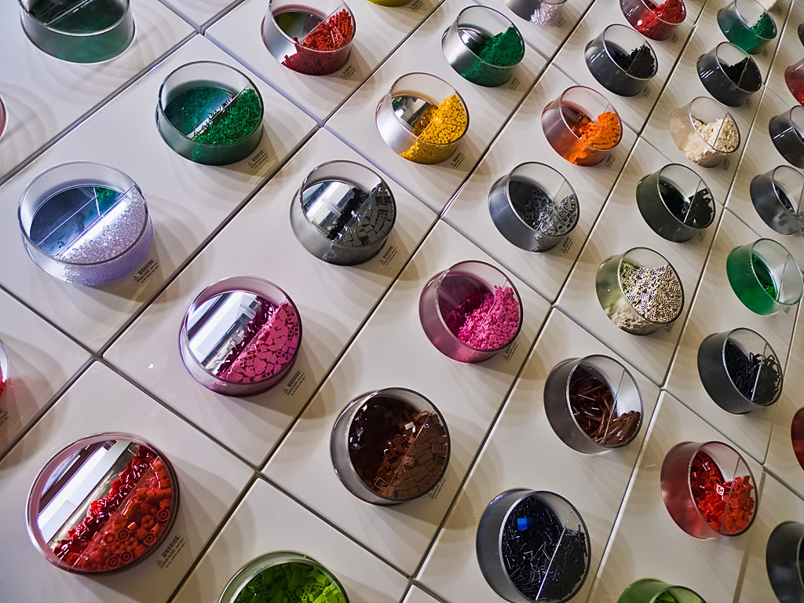
web building blocks
flickr.com/photos/saeba
flickr.com/photos/timbradshaw
Notes:
All of this power and flexibility does come with a cost, Drupal can be very complex and comes with a learning curve.
The Open Enterprise distribution greatly simplifies the common things businesses and organizations want to do with Drupal.

Slide 18
The platform – open enterprise
Open Enterprise apps
Open Enterprise core
Drupal
Notes:
Lets start with the tools. There is one primary tool we will spend our time focused on. It is the platform that enables us to build our website and do all kinds of other remarkable things.
This platform is called Open Enterprise. Open Enterprise is an extended distribution of the world’s most popular advanced open source site builder called Drupal.
It is an erector set for building websites. It is free and open source. But it is not a cheap toy. It powers some of the world’s top websites such as whitehouse.gov, The Economist and Examiner, all of Sony / BMG’s mission websites.

Slide 19
CMS driven web development
Focus shifts from “how do we build it” to “what should we build”
Notes:
Install DAMP, import OE Core

Slide 20
Traditional web development process
Requirements
Concept
High-level requirements
Requirements gathering
Requirements spec
planning
Design
Product (UI) Design
Wireframes
Detailed Design
Functional specs
Implementation
Creative design
Content
Development
development
Verification
Unit testing
Acceptance testing
Beta testing
Maintenance
live
Notes:
This is how a traditional process for building a website. Or I should say, this is how a traditional website is supposed to be planned. Many larger sites are planned this way, but often to save cost steps might be skipped.

Slide 21
Why do we plan?
Certainty
Stakeholder utility
End user utility
On time
On budget
In Scope
Look and feel
Emotional branding
Organizational returns
Features
Usability & Experience
Features
Increased revenue
Reduced cost
Increased goodwill
Content
typical
results oriented
Notes:
You might be saying wow that is a lot of planning. Why is it important to do that planning

Slide 22
Why should we plan?
Maximize organizational returns
Optimize user experience
Reduce waste
returns
user experience
stakeholder
utility
certainty
waste
Notes:
There is a

Slide 23
Big Design Up Front
6 months
returns
$
user experience
stakeholder
utility
certainty
waste
Notes:
Our first web project at LevelTen back in 1999 was truly a big design up front. Planning took 6 months. Numerous meetings, interviews, surveys, user focus groups, wireframes, UML based functional specs.

Slide 24
Mid Design Up Front
6 weeks
returns
user experience
$
stakeholder
utility
certainty
waste
Notes:
Then then 2001 resession hit. People no longer wanted to spend six figures on project planning. The shift was on to compressed planning phases. I call this mid design up front. The primary focus of MDUF was quickly gathering the stakeholders requirements and engineering just enough to get a reasonable estimate for budgets and timelines.

Slide 25
Planning for certainty
=
certainty
waste
source: blogs.msdn.com/b/dannawi/archive/2009/05/15/2009-standish-chaos-report-we-are-successful-in-the-failure.aspx
Notes:
So how successful do you think these the big and midsized design up front process was at brining projects in on time, on budget, and in scope?
[show slide]
Pretty horrible. The average project is 45% over budget, 63% late and missing 1/3 of the originally promised features.

Slide 26
Getting what you want vs. knowing what you want
Freedom to innovate
=
certainty
less stakeholder
utility
innovation
=
$
Insight to innovate
stakeholder
utility
more money
time
high level
requirements
design & architecture
mockups
validation
live
Notes:
There is another significant problem with traditional waterfall processes. We force stakeholders to make the big decisions when they know the least amount about the best solution.
So certainty also means that stakeholders get less of what they want.

Slide 27
Where to go
Mid DUF
Big DUF
Agile
certainty
value
waste
$
cost
$
$
Notes:
Then then 2001 resession hit. People no longer wanted to spend six figures on project planning. The shift was on to compressed planning phases. I call this mid design up front. The primary focus of MDUF was quickly gathering the stakeholders requirements and engineering just enough to get a reasonable estimate for budgets and timelines.

Slide 28
A better approach
waterfall
agile
Requirements
Design
Implementation
Verification
Requirements
Design
Implementation
Verification
website
6 months
features
2 weeks

Slide 29
Light weight planning
2 weeks
returns
user experience
$
stakeholder
utility
certainty
waste
Notes:
Agile processes are

Slide 30
Results oriented light weight planning
4 weeks
returns
user experience
$
$
stakeholder
utility
certainty
waste
Notes:
Agile processes are

Slide 31
To summarize
agile project management
more stuff
online results
results oriented user-centered planning
the right stuff
a.k.a more of the right stuff
Notes:
It powers some of the world’s top websites such as whitehouse.gov, The Economist and Examiner, all of Sony / BMG’s mission websites.

Slide 32
Process
Models based
Light weight
Iterative
Comprehendible by everyone
Synchronization
Collaboration
Types of models
User role models
Results models
User stories
Interface models
Participatory workshops
Rapid
Synergistic
Comprehensive
Consensus
Notes:
It powers some of the world’s top websites such as whitehouse.gov, The Economist and Examiner, all of Sony / BMG’s mission websites.

Slide 33
User role modeling
Process
Brainstorm
Organize
Consolidate & refine
Define
Prioritize
Definition:
a collection of defining attributes that characterize a population of users and their goals, needs and intended interaction with the site
Notes:
It powers some of the world’s top websites such as whitehouse.gov, The Economist and Examiner, all of Sony / BMG’s mission websites.

Slide 34
User role modeling: brainstorm
local newspaper
people from out of town
bike shoppers
Job seekers
sports blogger
fans
person who wants to upgrade their bike
new mom/parent
website administrator
staff
competitive rider
casual bikers
hotels that need bikes for guests
new bike rider
bike owners
tour guide
Notes:
It powers some of the world’s top websites such as whitehouse.gov, The Economist and Examiner, all of Sony / BMG’s mission websites.

Slide 35
User role modeling: organize
local newspaper
person who wants to upgrade their bike
staff
sports blogger
website administrator
fans
bike shoppers
new mom/parent
Job seekers
people from out of town
bike owners
hotels that need bikes for guests
competitive rider
tour guide
casual bikers
new bike rider
Notes:
It powers some of the world’s top websites such as whitehouse.gov, The Economist and Examiner, all of Sony / BMG’s mission websites.

Slide 36
User role modeling: consolidate & refine
enthusiasts
shoppers
staff
local newspaper
bike shoppers
staff
sports blogger
new mom/parent
website administrator
fans
person who wants to upgrade their bike
renters
owners
job seekers
tour guide
bike owners
job seekers
people from out of town
casual bikers
new bike rider
hotels that need bikes for guests
competitive rider
Notes:
It powers some of the world’s top websites such as whitehouse.gov, The Economist and Examiner, all of Sony / BMG’s mission websites.

Slide 37
User role modeling: define
Demographics
Age: 25-55
Gender: 65% male
Location: within 10 miles of store
Psychographics
Active lifestyle
Prefers being outdoors
Green
Behavioral
Significant web usage including search engines and social media
Research purchases online before buying
Significant use of mobile devices
Brand
Custom service is significant driver for brand loyalty
Likely to buy again from same store. Typically 1 bike every 4 years.
Site
Proficient web user
Likely to have high speed internet access
owners
Notes:
It powers some of the world’s top websites such as whitehouse.gov, The Economist and Examiner, all of Sony / BMG’s mission websites.

Slide 38
User role modeling: personas
renter
Notes:
It powers some of the world’s top websites such as whitehouse.gov, The Economist and Examiner, all of Sony / BMG’s mission websites.

Slide 39
User role modeling: prioritize
Primary
Secondary
Tertiary
shoppers
enthusiasts
job seekers
renters
staff
owners
Notes:
It powers some of the world’s top websites such as whitehouse.gov, The Economist and Examiner, all of Sony / BMG’s mission websites.

Slide 40
Results modeling
Process
Brainstorm
Organize
Consolidate & refine
Prioritize
Definition:
the benefits stakeholders want to achieve with the site.
Notes:
It powers some of the world’s top websites such as whitehouse.gov, The Economist and Examiner, all of Sony / BMG’s mission websites.

Slide 41
Results modeling: types of results models
objectives
goals
valued events
Notes:
It powers some of the world’s top websites such as whitehouse.gov, The Economist and Examiner, all of Sony / BMG’s mission websites.

Slide 42
Results modeling: brainstorm
increase bike sales
The site should have a clean and professional look
Reduce routine customer call inquires by 50%
Staff should be able to add and edit content
become a recognized leader in the local biking community
Be more viral
Sell more bike repair services
Expand our digital footprint
Show the pictorial history of results bikes
To increase traffic to the site
Sell more bikes online
Get 500 “Likes” on Facebook
The site should be intuitive and easy to navigate
Increase bike rentals by 100%
Double our mailing list
Visitors should be able to find what they want in no more than 3 clicks
Notes:
It powers some of the world’s top websites such as whitehouse.gov, The Economist and Examiner, all of Sony / BMG’s mission websites.

Slide 43
Results modeling: organize
increase bike sales
Increase bike rentals by 100%
The site should have a clean and professional look
Sell more bikes online
The site should be intuitive and easy to navigate
Reduce routine customer call inquires by 50%
Show the pictorial history of results bikes
Sell more bike repair services
Visitors should be able to find what they want in no more than 3 clicks
To increase traffic to the site
become a recognized leader in the local biking community
Staff should be able to add and edit content
Be more viral
Expand our digital footprint
Get 500 “Likes” on Facebook
Double our mailing list
Notes:
It powers some of the world’s top websites such as whitehouse.gov, The Economist and Examiner, all of Sony / BMG’s mission websites.

Slide 44
Results modeling: consolidate
Goals
Objectives
Valued events
Features
increase bike sales
To increase traffic to the site
Increase bike rentals by 100%
Show the pictorial history of results bikes
become a recognized leader in the local biking community
Sell more bike repair services
Reduce routine customer call inquires by 50%
Staff should be able to add and edit content
The site should be intuitive and easy to navigate
Sell more bikes online
Double our mailing list
The site should have a clean and professional look
Expand our digital footprint
Visitors should be able to find what they want in no more than 3 clicks
Be more viral
Get 500 “Likes” on Facebook
Notes:
It powers some of the world’s top websites such as whitehouse.gov, The Economist and Examiner, all of Sony / BMG’s mission websites.

Slide 45
Results modeling: refine
Goals
Objectives
Valued events
increase bike sales
Increase by sales by 50% a month within 6 months
Bike purchase
Value = 40% of the retail price
Notes:
It powers some of the world’s top websites such as whitehouse.gov, The Economist and Examiner, all of Sony / BMG’s mission websites.

Slide 46
Results modeling: prioritize
Primary
Secondary
Tertiary
increase bike sales
Expand our digital footprint
Be more viral
Sell more bike repair services
To increase traffic to the site
Sell more bikes online
become a recognized leader in the local biking community
The site should be intuitive and easy to navigate
The site should have a clean and professional look
Notes:
It powers some of the world’s top websites such as whitehouse.gov, The Economist and Examiner, all of Sony / BMG’s mission websites.

Slide 47
User stories
Process
Brainstorm
Organize & refine
Prioritize
Definition:
describes a features and functionality of the site from the viewpoint of a user role
Notes:
It powers some of the world’s top websites such as whitehouse.gov, The Economist and Examiner, all of Sony / BMG’s mission websites.

Slide 48
User stories: format
As a [user role]
I want [a feature or goal]
so that [a benefit or reason]
* so that is optional
A user story is a documented requirement and a note to discuss later
Notes:
It powers some of the world’s top websites such as whitehouse.gov, The Economist and Examiner, all of Sony / BMG’s mission websites.

Slide 49
User stories: brainstorm
As a Bike Enthusiast, I would like to
read the latest bike shop news/blog
comment on the blog
share content through email and social media
see a calendar of events, classes, races
sign up for newsletter and alerts
see special offers
get contact information
see location and hours of operation
Notes:
It powers some of the world’s top websites such as whitehouse.gov, The Economist and Examiner, all of Sony / BMG’s mission websites.

Slide 50
User stories: prioritize
MoSCoW approach
Must haves – we need these stories in order to launch the project
Should haves – these are of high importance, but are not show stoppers for the next release
Could haves – If we get a couple of these in it would be nice, but they can be moved easily to the next release
Wants – These are not a priority but we want to keep track of them as possibilities for future releases.
Notes:
It powers some of the world’s top websites such as whitehouse.gov, The Economist and Examiner, all of Sony / BMG’s mission websites.

Slide 51
Interface models
Common interface models
Navigation Architecture & maps
Content Models
Wireframes and prototypes
Design comps
Definition:
graphical or organizational representation of site elements and how they relate to each other
Notes:
It powers some of the world’s top websites such as whitehouse.gov, The Economist and Examiner, all of Sony / BMG’s mission websites.

Slide 52
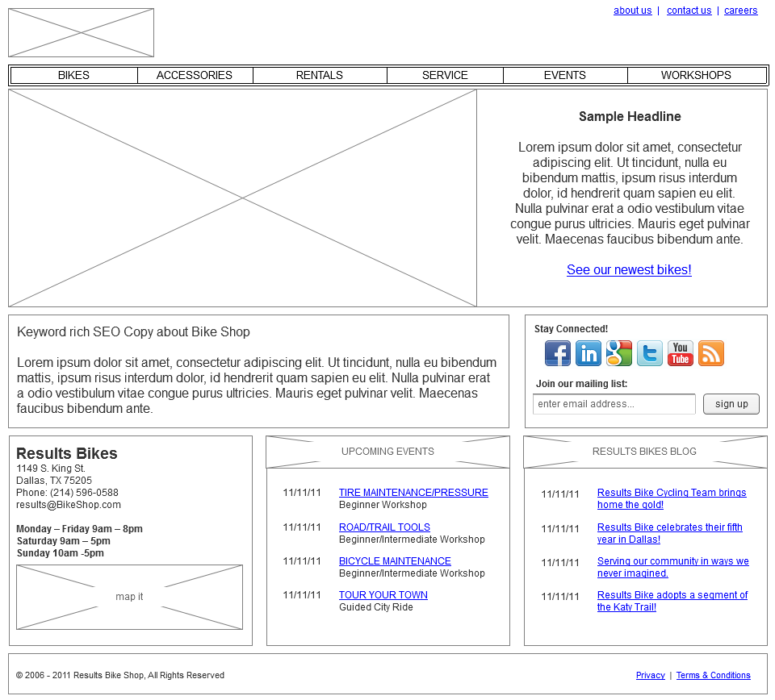
Interface models: wireframes
Notes:
It powers some of the world’s top websites such as whitehouse.gov, The Economist and Examiner, all of Sony / BMG’s mission websites.

Slide 53
Project management methodologies comparison
 | Cowboy | Agile | Waterfall
Requirements | Little formal requirements | Lightweight, structured | Very formal Big Design Up Front
Owner - team Agreements | Usually fixed bid, poorly defined scope. | Typically fixed budget or fixed scope – value based | Initially fixed bid by stages. Modified by change orders.
Owner – team relationship | Undefined | Collaborative | Contractual
Owner – team communication | Whenever | Cycle every 1-4 weeks | At major milestones. May be months apart.
Improvement changes requests | Whatever | Discussed each cycle – better ideas easily integrated | Formal change order process built to resist change
Risk management | ??? | Adaptive - by doing, inspecting and adapting | Predictive – by planning
Notes:
Install DAMP, import OE Core

Slide 54
Installation
Exercises
Notes:
Install DAMP, import OE Core

Slide 55
thank you!
Tom McCracken
LevelTen Interactive
Director
Phone: 214.887.8586
Email: tom@leveltendesign.com
Twitter: @levelten_tom
Blog: leveltendesign.com/blog/tom
LinkedIn: linkedin.com/in/tommccracken
flickr.com/photos/dcsf2010/4561985806
flickr.com/photos/x-foto/4923221504
flickr.com/photos/slack13/2683947718
flickr.com/photos/23912576@N05/3902271512
flickr.com/photos/acmace/441065062
flickr.com/photos/jenaardell/4434366505
flickr.com/photos/deciter_interactions/4052969929
flickr.com/photos/svenwerk/858381180
flickr.com/photos/fredcavazza/3428921418
flickr.com/photos/tinou/2065322341
flickr.com/photos/svenwerk/858381180
flickr.com/photos/nilson/255662963
flickr.com/photos/genista/3432987963
flickr.com/photos/vernhart/1073265478
flickr.com/photos/paullew/4304362073
flickr.com/photos/soldiersmediacenter/397695157
flickr.com/photos/28634332@N05/4054720616

